Slide 1
Technical Writing Presentation
Group B - Section B
Anju Shahi
Sagar Giri
Suman Thapa
Krishna Chauhan

Slide 2
Weekly page reach by demographics (Male & Female)
Sagar Giri

Slide 3
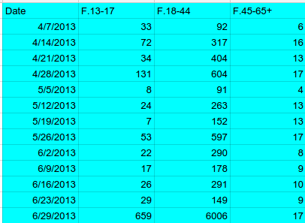
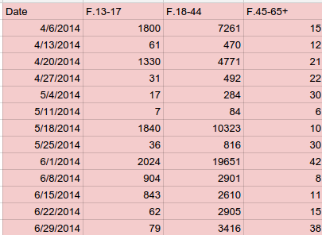
Data comparison 2013 Vs. 2014 - Female
1
2013
2014

Slide 4
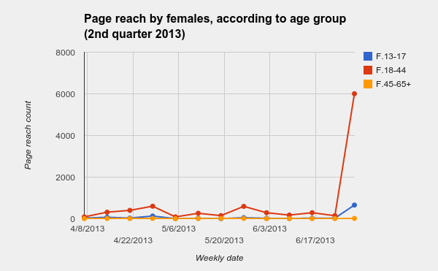
2

Slide 5
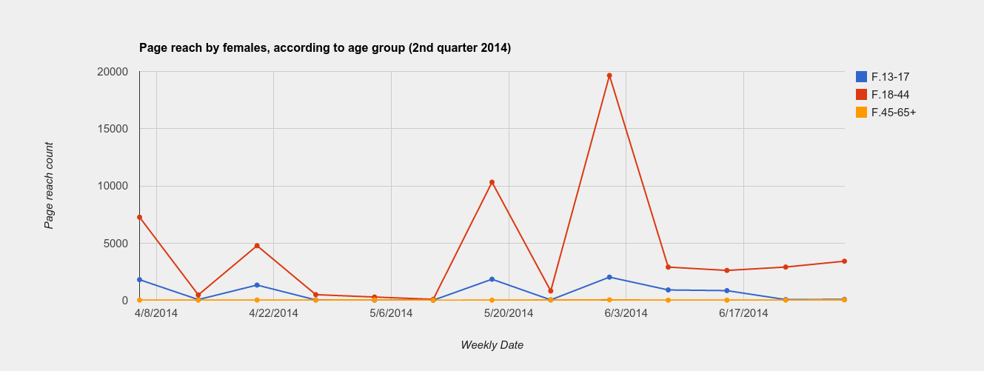
3

Slide 6
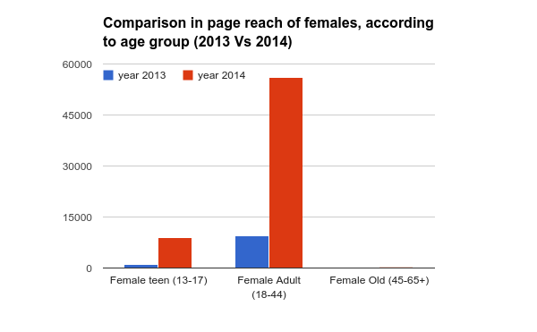
4
Comparison (2013 Vs. 2014) - Female

Slide 7
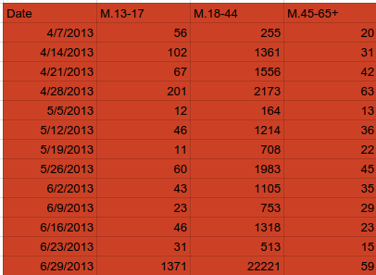
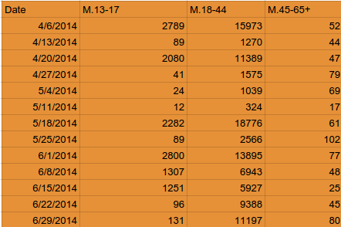
Data comparison 2013 Vs. 2014 - Male
5
2013
2014

Slide 8
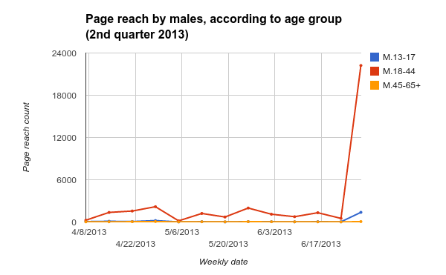
6

Slide 9
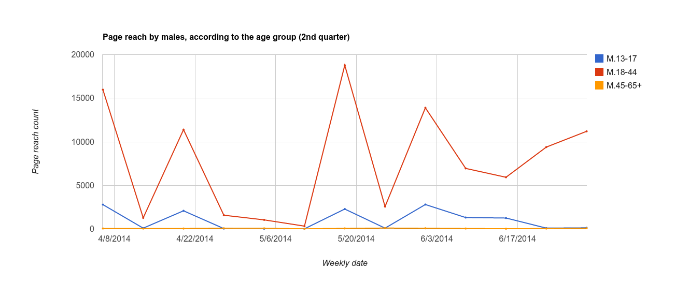
7

Slide 10
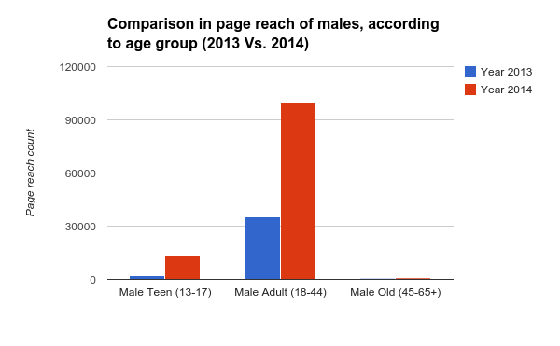
8
Comparison (2013 Vs. 2014) - Male

Slide 11
9
Male 2014 Vs. Female 2014

Slide 12
Thank You

